Slide 1

Stakeholder Engagement during
Pollution Incidents
Integrative Learning Experience
May, 2022
Meaghan Chesley, Kari Furrow, Kevin Laoh

Slide 2

Objectives
Develop a stakeholder engagement plan in response to pollution emergencies for the Virginia Department of Environmental Quality (DEQ) building on the Eastern Shore Annex under the Virginia Area Contingency Plan
Expand and diversify communication
Explore stakeholder challenges and concerns
Empower community members
Notes:
The project’s PRIMARY goal is to develop a stakeholder engagement plan in response to pollution emergencies for VA Department of Environmental Quality (also known as DEQ)- Mainly utilizing the Eastern Shore Annex under the VA Area Contingency Plan (...which will be elaborate shortly)
Some of the initial objectives that gave purpose to this project —
Expand and diversify communication strategies:
During an environmental emergency → federal, state and local response partners engage in limited forms of communication to inform the community of the pollution incident, and the nature & extent of potential public health & environmental impacts
Explore stakeholder Challenges and Concerns:
social determinants that limit access to resources
dependence on informal sources/networks for information
distrust of government; ability OR inability to understand or act on the info provided
Give a sense of empowerment as community members can participate in the mitigation and response of emergencies:
By generating a plan to guide response, the affected community can be better served by stakeholders as well as the key players within said community

Slide 3
Goals of the DEQ Framework
As part of the Eastern Shore exercise, DEQ and its planning partners recognized the input of the community stakeholders is of utmost importance
Identify Stakeholders
    Those affected by incidents
    Include those that have historically not been included
Identify Engagement options
    Key considerations before, during, and after a response
    Communication strategies
    Evaluation strategies
Develop Strategies for disseminating technical information
    To address stakeholder and community questions and concerns
    Transparency in response activities
Notes:
As part of the Eastern Shore exercise, DEQ and its planning partners recognized the input of the community stakeholders is of utmost importance
drafted a community engagement plan to outline the process for receiving community feedback during a response action.
DEQ plans to use our framework as a guide for leading their future engagement plans for pollution incidents
⇒ we begin with identifying stakeholders..
Develop Strategies for disseminating technical information
To address stakeholder and community questions and concerns ⇒ especially during an emergency which can affect the health of the local communities
Transparency in response activities

Slide 4

Stakeholder Engagement
Stakeholder Engagement: “...the process of working collaboratively with and through groups of people affiliated by geographic proximity, special interest or similar situations to address issues affecting the well-being of those people.” (CDC, 1997)
Notes:
Stakeholder Engagement (or sometimes referred to Community engagement)
requires an understanding of the identified community and local issues (ex. a pollution problem that will affect the wellbeing and health of the community), requires also a listening environment, and continuous communication
It includes multiple opportunities for collecting citizen input through interaction and dialogue and identification of local solutions
In summary, there should always be a well-designed plan for inviting citizens to be part of a conversation

Slide 5

Key and Overarching Considerations
“Some overarching considerations do apply to all stages of the engagement. They are important to consider and keep in mind when responding to the needs of stakeholders and the community“ (Bassler et al, 2008):
  Potentially non-homogenous groups of people are involved as potential stakeholders
  Direct and indirect participation of underrepresented groups
  Clarity in language and definitions
Notes:
The key considerations covered in our framework can be used throughout the different stages of engagement
starting with design, execution and finally the follow up stage
Additionally, some overarching considerations apply to all stages of the engagement. ⇒ They are important to consider and keep in mind when responding to the needs of stakeholders and the community
Many different groups of people are involved as potential stakeholders - other city government agencies, community organizations, faith-based organizations, schools, academic institutions, and residents living in the location
Direct and indirect participation of neighborhood residents or other members of cultural, religious, social or political communities in addressing issues directly affecting that population
Clarity in the language is important - people use similar terms in different ways ⇒ include a glossary of terms / definitions used throughout the document to ensure clarity

Slide 6
Key Considerations
Considerations before engagement | Considerations for engagement retention | Considerations for engagement to succeed
Being clear and direct | Create and nurture a presence | Sustained communication
Defining the community and identify all stakeholders | Ensure partners are fully committed and follow through | Leverage community strengths to sustain commitment and build community capacity
Carrying out the research about the affected community | Build and continuously include diverse and varied partnerships | Remain open minded and assess lessons learned
Assessing existing internal capacity and resources for engagement | Continuously assess the process throughout the engagement | Continually assess sustainability & effectiveness of the strategy, while keeping in mind shared leadership.
Notes:
Considerations before engagement
Take time to be clear and direct about the purpose, goals, and desired outcomes of the engagement
Define all potential stakeholders and particularly the portion of the community that wants to be engaged
Carry out the research and become knowledgeable about the affected community
Assess existing internal capacity and resources for engagement
Considerations for engagement retention
Create and nurture a presence in the affected community and neighborhoods to keep building relationships and trust with community leaders
Ensure partners are fully committed and follow through with the agreement to join the initiative
Build and continuously include diverse and varied partnerships across the many sectors in the community
Reflect on and continuously reassess the process throughout the initiative
Considerations for engagement to succeed
Sustain communication and determine which strategy works best to create and maintain direction of community engagement
Leverage community assets and strengths to sustain commitment and build community capacity by reinforcing access to networks and resources
Be open to addressing new issues that may arise during engagement. New issues may have different priorities to the community members than what was originally discussed on the proposed agenda
Build on lessons learned during engagement processes
While investing resources (both time and money) in building and maintaining partnerships, continuously assess the sustainability and effectiveness of the strategy
I want to also stress that …
“Stakeholder engagement occurs successfully when there is an ongoing cumulative process enabling relationships and trust to build”

Slide 7
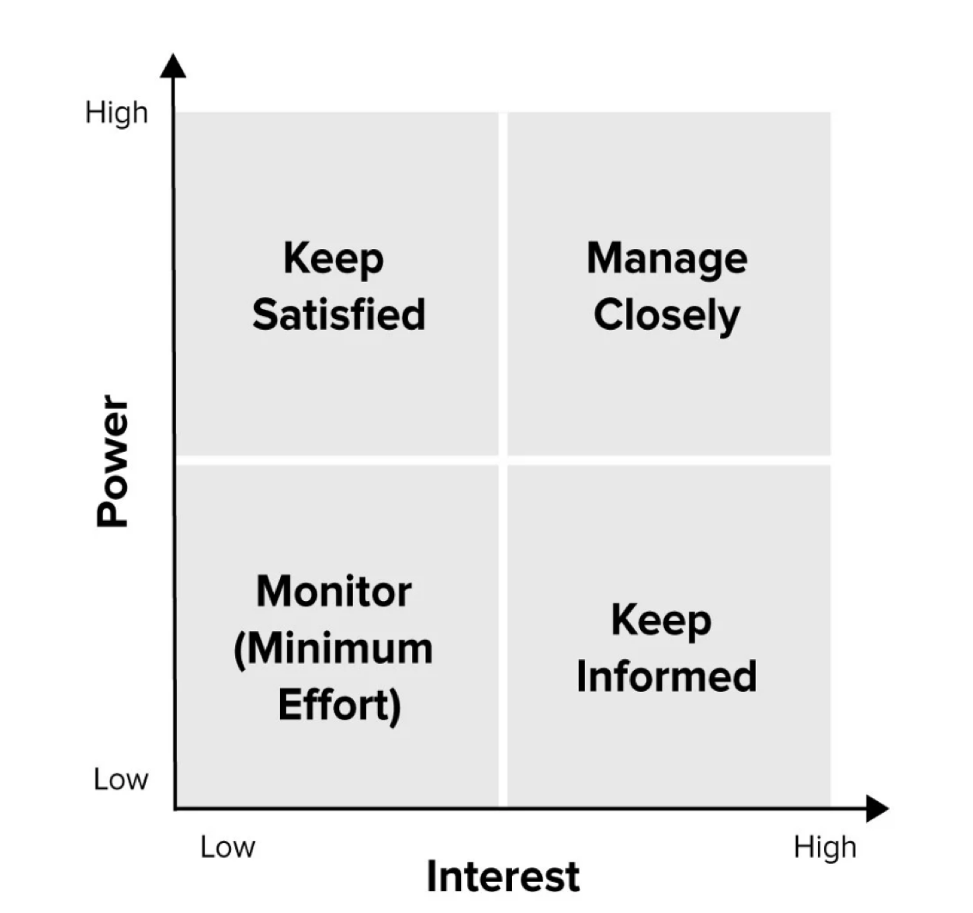
Identifying and Selecting Stakeholders
Step 1: Identify starting at geographic location and working through community
  Source-Pathway-Receptor
Step 2: Categorize by Stakeholder Analysis (power and interest)
Categories:
  High-power, high-interest
  Low-power, high-interest
  High-power, low-interest
  Low-power, low-interest
Notes:
A stakeholder should be defined as an individual or entity involved or impacted by the incident at hand (whether directly or indirectly) that should know or care about the incident.
This includes (but is not limited to) individuals, residents, business owners, property owners, community organizations, workers that could have been exposed, parents/guardians if a childcare center or school is involved, government officials, etc.
Any citizen who has questions or concerns about the incident can also be considered a stakeholder, as they hold interest in being informed, even though they may not be directly affected, their needs and questions should still be identified throughout the response and engagement period.
Before a pollution incident occurs, certain stakeholders in communities can be pre-identified.
Each stakeholder can be uniquely identified and evaluated according to their power and influence in comparison to their interest level to the incident (ex: were they directly affected?).
The Stakeholder Analysis is a tool to aid in this categorization. In this context, power is defined as given authority or influence the individual or group has within the community.
High power groups can be strongly influential organizations or groups that have a strong presence and voice in the community. For example, community taskforces.
Interest is determined by impact and proximity to the incident. Those directly affected should be considered of high interest whereas other members of the community not directly affected may still have an interest and should be kept informed; however, it is not as crucial or timely to inform these individuals as others.
An important consideration when categorizing these stakeholders is the specific incident at hand. During a different incident in the same geographical location, it is possible for a stakeholder to change categories thus, a new categorization process should be done for every incident for the most appropriate engagement strategies to be deployed

Slide 8
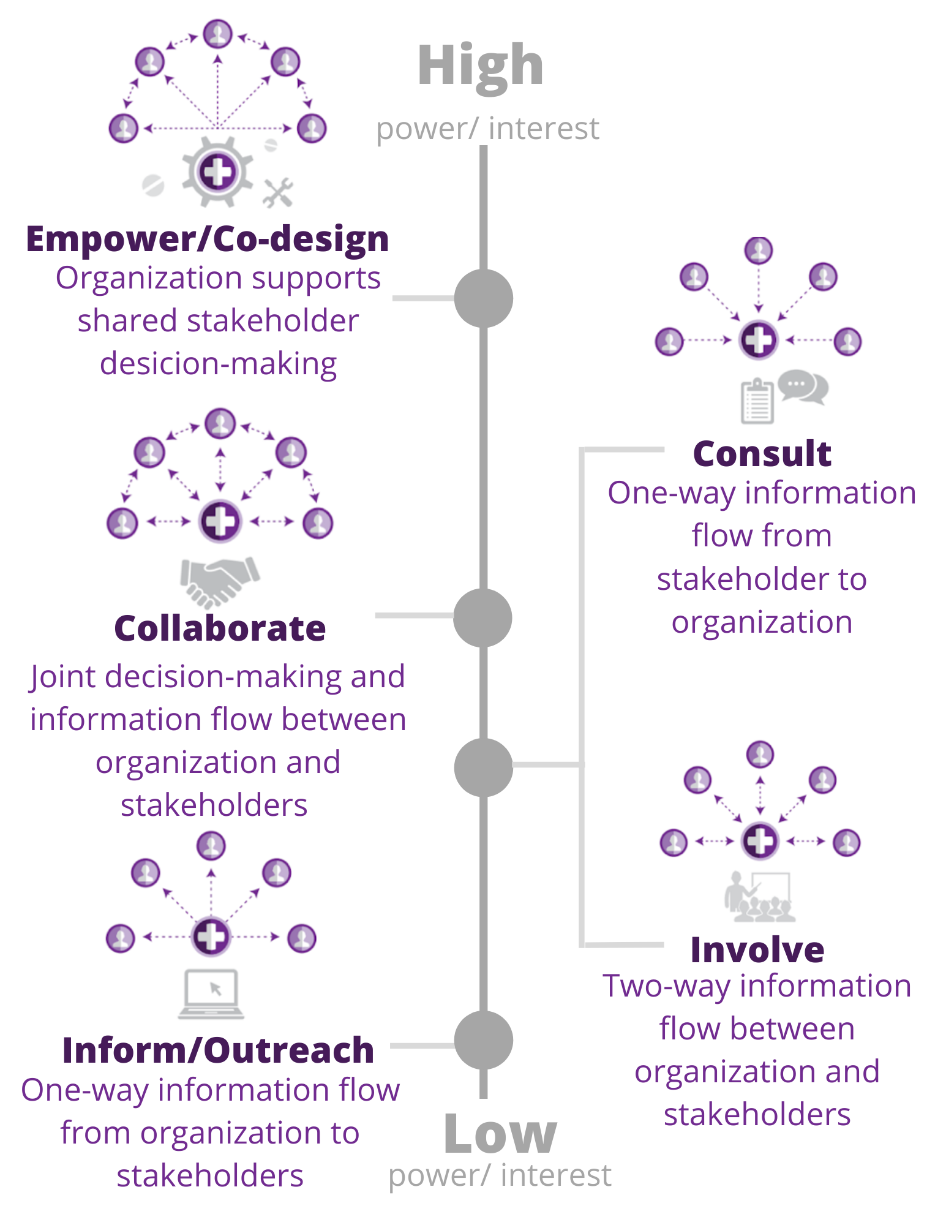
Levels of Engagement
Each category has its own level
Levels:
  Inform/Outreach — low-power, low-interest
  Involve/Consult –high-power, low-interest
  Collaborate – low-power, high-interest
  Shared Leadership/Co-design – high-power, high interest
Notes:
- Look over chart and include example of each when giving presentation
Chart moves from low to high power and interest with different level of strategy for each..
Inform/Outreach - This is a low level engagement and unidirectional flow of information coming from DEQ or high-power partners. This strategy is best for low-power, low-interest stakeholders. I.e. public announcements and postings
Involve/Consult - This is a low to middle level engagement and single bidirectional flow. This is best fit for high-power, low-interest groups. This strategy, specifically consultation, can be utilized when a stakeholder group has expertise and can offer recommendations but has low interest in terms of being affected or does not want to be fully involved in decision-making processes.i.e. Consulting stakeholders who may be knowledgable about the subject but are not directly affected or may not want to be involved in a decision-making process
Collaborative - This is a middle to high level engagement and bidirectional flow. Collaboration is best fit for low-power, high-interest. It is best practice to have community members involved and ‘in the loop’ when it comes to incidents but they do not necessarily have to be involved with every decision to be made. – feedback and input from the community groups
Shared Leadership/Codesign - This is a high level engagement and strong/rigorous open flow. For this engagement, high-power, high-interest people and organizations are part of the decision-making and community engagement processes. - involved in leadership and full decisions-making

Slide 9

Engagement Strategies
Take into consideration environmental, economic, social, mental health factors in designing engagement strategies.
Distribute information and public health materials by traditional means, including community-driven channels (newsletters, etc.)
Collect feedback via surveys, questionnaires, facilitated discussions, focus groups, interviews, community input sessions, advisory boards
Involve stakeholders and partners to set common goals for engagement strategies and obtain feedback or input
Establish shared framework for performance measurement
Notes:
Take into consideration environmental, economic, social, mental health factors in designing engagement strategies.

Slide 10
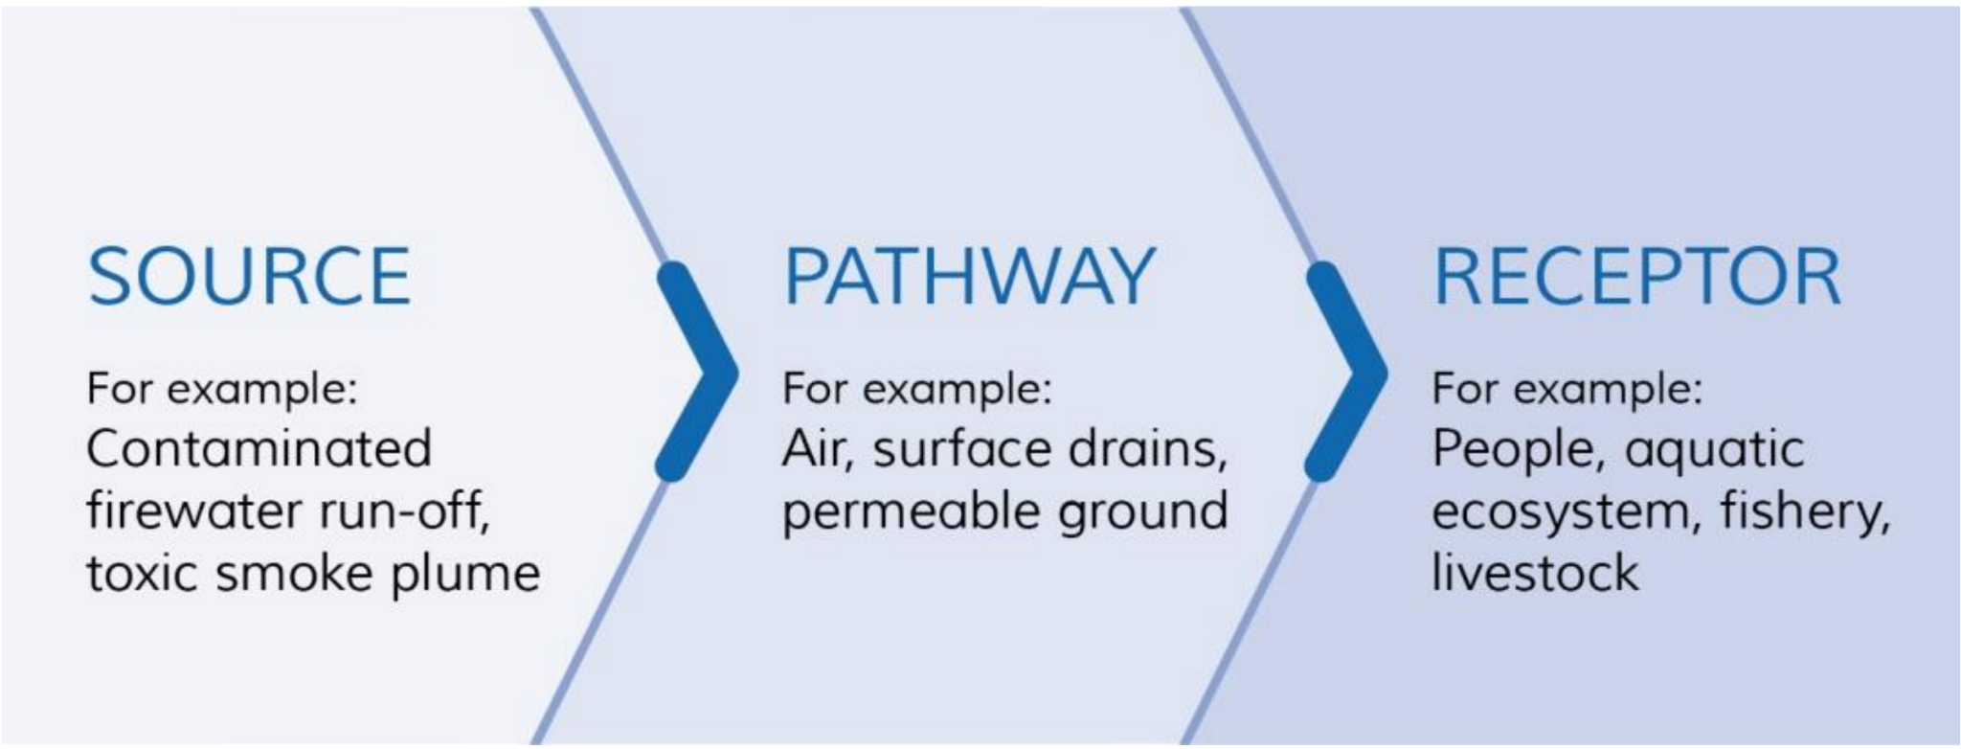
How to Communicate Technical Information
Using a Source-Pathway-Receptor model helps compartmentalize information into a logical flow of ideas.
This helps explain the event, plan mitigation strategies, and disseminate information.
Notes:
Bring in SMEs

Slide 11

Measuring Success & Evaluation Strategies
Process Evaluation
  Track how well the engagement implementation is following the selected strategy, e.g., inclusion of appropriate stakeholders, is information being disseminated, feedback being captured
Summative Evaluation
  Occurs at end of event and captures lessons learned and level of stakeholder satisfaction via feedback surveys, interviews, etc.
Notes:
Two types of evaluations can be utilized for stakeholder engagement: process evaluation and summative evaluation.
Process evaluation is to be done while the engagement is taking place. This is done by tracking how well the engagement implementation is following the strategy selected (i.e. are the correct levels of engagement being utilized, are the appropriate stakeholders being included in decision-making processes, are all groups being informed in a way the information is getting to them). This evaluation strategy can be used by constantly referencing the engagement strategy (and this framework) and by communication with high-power stakeholders to ensure their needs are being addressed.
The second evaluation strategy, summative, is done at the end of the engagement period. This is where engagement effectiveness is evaluated, lessons can be learned (as to what worked well and what did not), and changes can be implemented during future incidents. As mentioned earlier, engagement should be flexible and adapted to the specific situation at hand and lessons should be learned during each response to continually improve the processes and strategies. Summative evaluation can take place in the form of surveys sent out to each different category of stakeholder to determine how satisfied they were with the levels of engagement deployed to them. It should be noted again that surveys, face-to-face interviews, or other types of data collection should be accessible to the audience and enough data and information should be collected to accurately represent the majority opinion for that category of stakeholders.

Slide 12
Benefits of a Stakeholder Engagement
Increase the likelihood that projects or solutions will be widely accepted
Empower and integrate people from different communities and backgrounds
Increase trust in community organizations and governance
Receive and provide timely and accurate information to and from authorities
Improve knowledge and skills in contextual problem solving
Facilitate opportunities for discussing current and future concerns
Notes:
Increase the likelihood that projects or solutions will be widely accepted:
Prevent and mitigate fear-based hesitancy from local partners and the community ⇒ regular, on-going forums ⇒ express concerns before problems become too big or out of control
Empower and integrate people from different communities and backgrounds
Increase trust in community organizations and governance
Working together improves communication — it promotes understanding and empathy (important aspect to SE) between multiple groups and disciplines
Receive and provide timely and accurate information to and from authorities
This very much applies to toxic spills or incidences that have adverse health effects in the community ⇒ time sensitive
Improve knowledge and skills in contextual problem solving
By having participants learn about the issues in-depth, the greater knowledge may allows stakeholders to see multiple sides of the problem
Facilitate opportunities for discussing current and future concerns

Slide 13
Questions?

